Slide 1

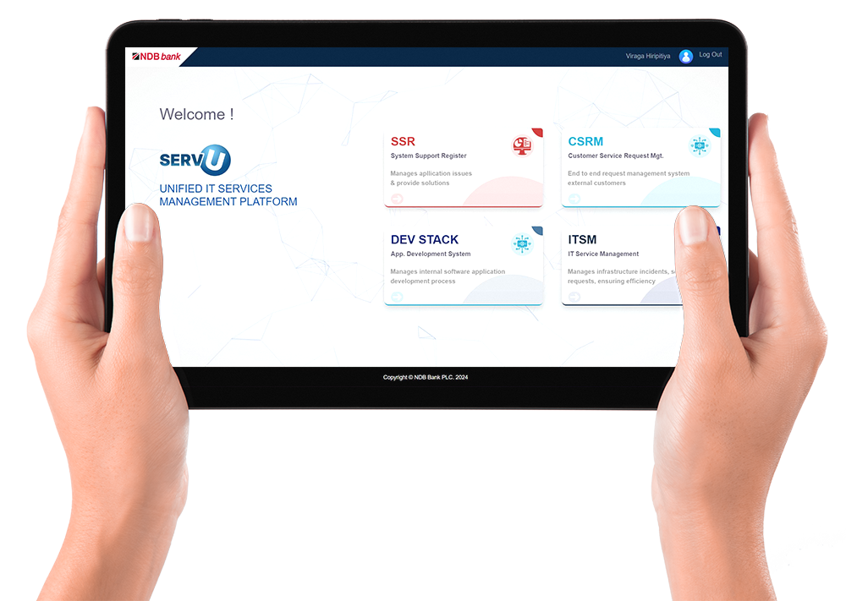

WELCOME

Slide 2
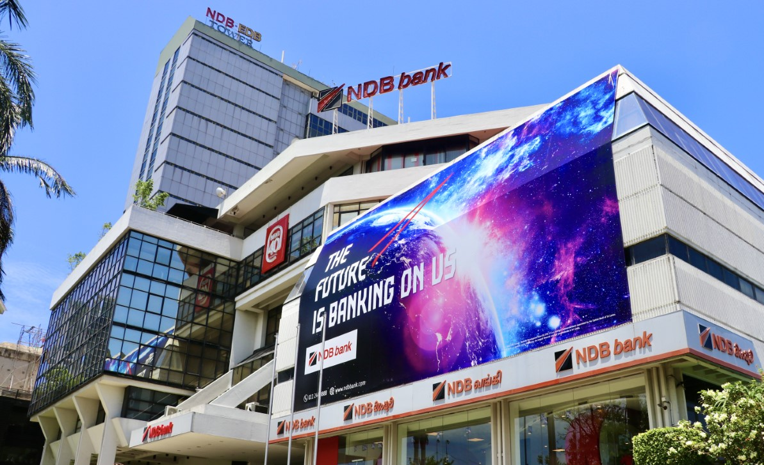

WELCOME
UNIFIED
IT SERVICES MANAGEMENT
PLATFORM
www.ndbbank.com

Slide 3

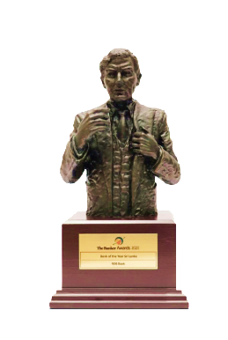



COMPANY PROFILE
Established in
1979
Staff Strength
3000
Our Vision
The driving force for a financially empowered Sri Lanka
Our Mission
To be the catalyst in the financial services industry by creating superior shareholder value and contributing to the national development through the empowerment of individuals with innovative financial solutions delivered by an inspired and dedicated team committed to excellence.
Total Assets
LKR 833 Bn
Profit After Tax
LKR 2.9 Bn
The Banker of UK
(2021/2022)
Best Digital Bank
(2021)

Slide 4









PREVIOUS PROCESS
04
Start
Medium :
Calls, Email
Customer Service Requests
Request analysis by Call center
Reject request (To create new request & start over)
Medium :
Calls, Email, Existing system
Request
completion
Request
initiation
Support Initiation Request/Parameter change/Product creation
Request close
End
Request initiation
Medium :
Calls, Email,
Help Desk system
Notes:
Presented content Ok

Slide 5



CHALLANGES
Entirely manual handling of all service offerings
High risk of errors leading to inconsistencies and potential service disruptions
Inefficient tracking and reporting mechanisms
Lack of standardization causing variability in service delivery and quality
Labor-intensive and time-consuming processes
Limited scalability and security management
Notes:
Marketing story to continue

Slide 6



NEW PROCESS
Dev
Stack
Business Requirement
Assign PM & Priority
Development
QA
UAT
Request Closure
Start
ITMS
Service
requests
Initiate Service request
Assign to user
Complete
Service request
Close Service
request
Incident review
& feedback
Service Desk
SSR
Subtask
Creation
Complete
Incident
Close Incident
Review Incident
System issues, Parameter changes, Product creation directed to App Support
Incident
management
Initiate incidents
Assign to user
Escalation/Transfer to
respective team
CSRM
Initiate Request
Business Approval
AS team task completion/
rejection
UAT Sing-off/Rejection by the business
IT CMC / Special approval
Deployment
request closure and feedback
Bank Wide Service Requests, Concerns, Suggestions, leads, initiatives & compliments directed to customer center
End
Initiate Request
Inputter Verification
Request Authorization
CC Request Completion
auto assignment to relevant department/section for processing
Notes:
Marketing story to continue

Slide 7

PRODUCT OVERVIEW
INTERNAL
ITSM
ITSM ensures the smooth and efficient management of IT infrastructure incidents, service requests, and operations, including access, change, asset management, and vendor SLAs.
SSR
SSR manages real-time issues and bugs, providing immediate solutions to maintain system stability and reliability.
DevStack
DevStack manages the entire software development lifecycle, from planning to deployment, for internal applications.
EXTERNAL
CSRM
CSRM is an end-to-end system for efficiently managing customer service requests, streamlining the process from submission to resolution and feedback.

Slide 8











KEY BENEFITS
Seamless integration with Core-Banking and other systems
Real-time SLA matrix and priority adjustments
Performance dashboard for all IT service staff
Automatic closure and status notifications
IT asset tracking and internal development lifecycle management
Key insights & Bird’s eye view of requests
Robust issue tracking and increased customer satisfaction through user feedback
Cost-saving from in-house development
Fast resolutions using a centralized knowledge base
User-friendly interface and customizability
ChatBot for service desk
Notes:
Highlighted points:-
-Real time SLA matrix & priority adjustments
-Performance dashboard for all IT service staff & Birds eye view
-Cost-saving from in house-development

Slide 9

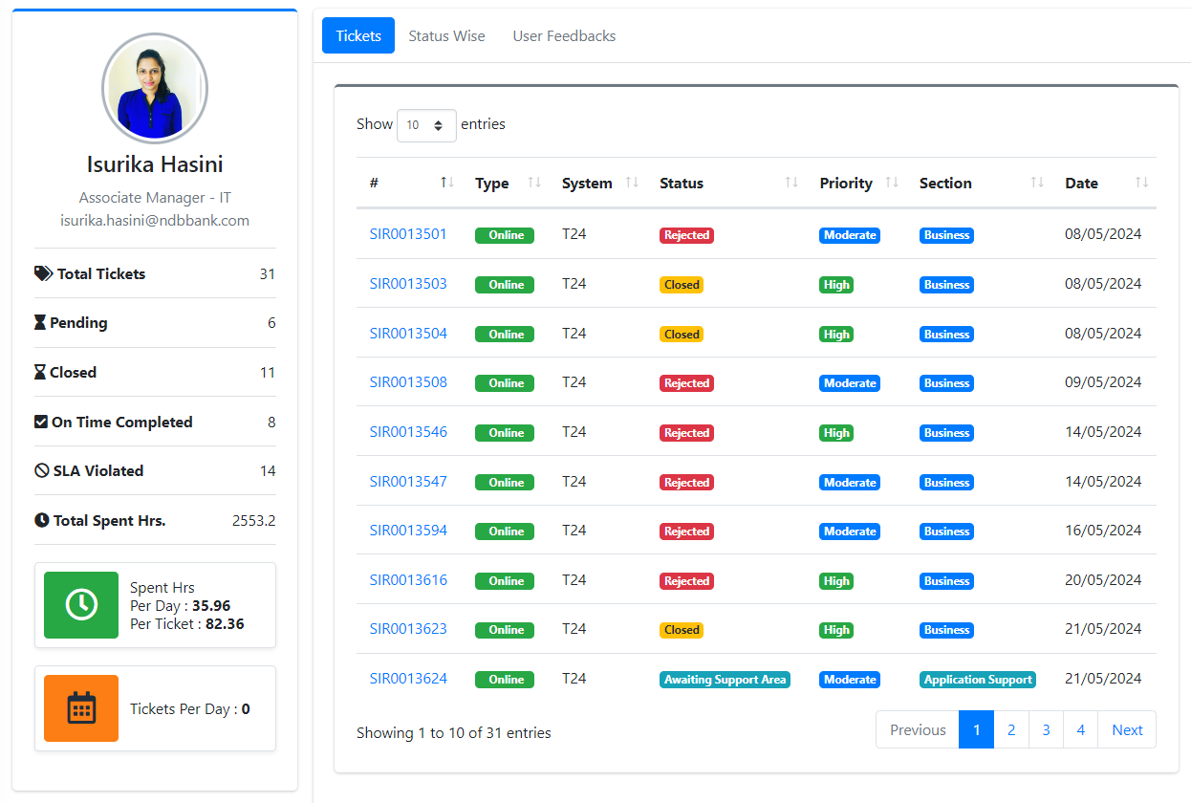
UNIQUENESS OF THE PRODUCT
Micro-service architecture and streamlined customer requests
Customer-Centric: ITSM prioritizes customer satisfaction by aligning IT services with business goals and user needs
Complete coverage of the bank’s IT Service catalogue and needs
Visibility over agent/user performance
Centralized Knowledge Base
Prioritization of requests with CMC/special approval
IT Asset Tracking & Lifecycle management
Notes:
Points notes-
*Micro service architecture – for ServU We are used micro service architecture, therefor all these modules can be deployed and scaled independently.
*Customer centric – end to end customer service with feedback
*Centralized knowledge base – Repeated

Slide 10





SYSTEM SECURITY FEATURES
Token/Role-based access management.
Audit trails, logging, session management.
SSO with AD Authentication, encryption, and SSL certification
Security acceptance testing and scheduled VA
Secure coding practices and paperless environment

Slide 11
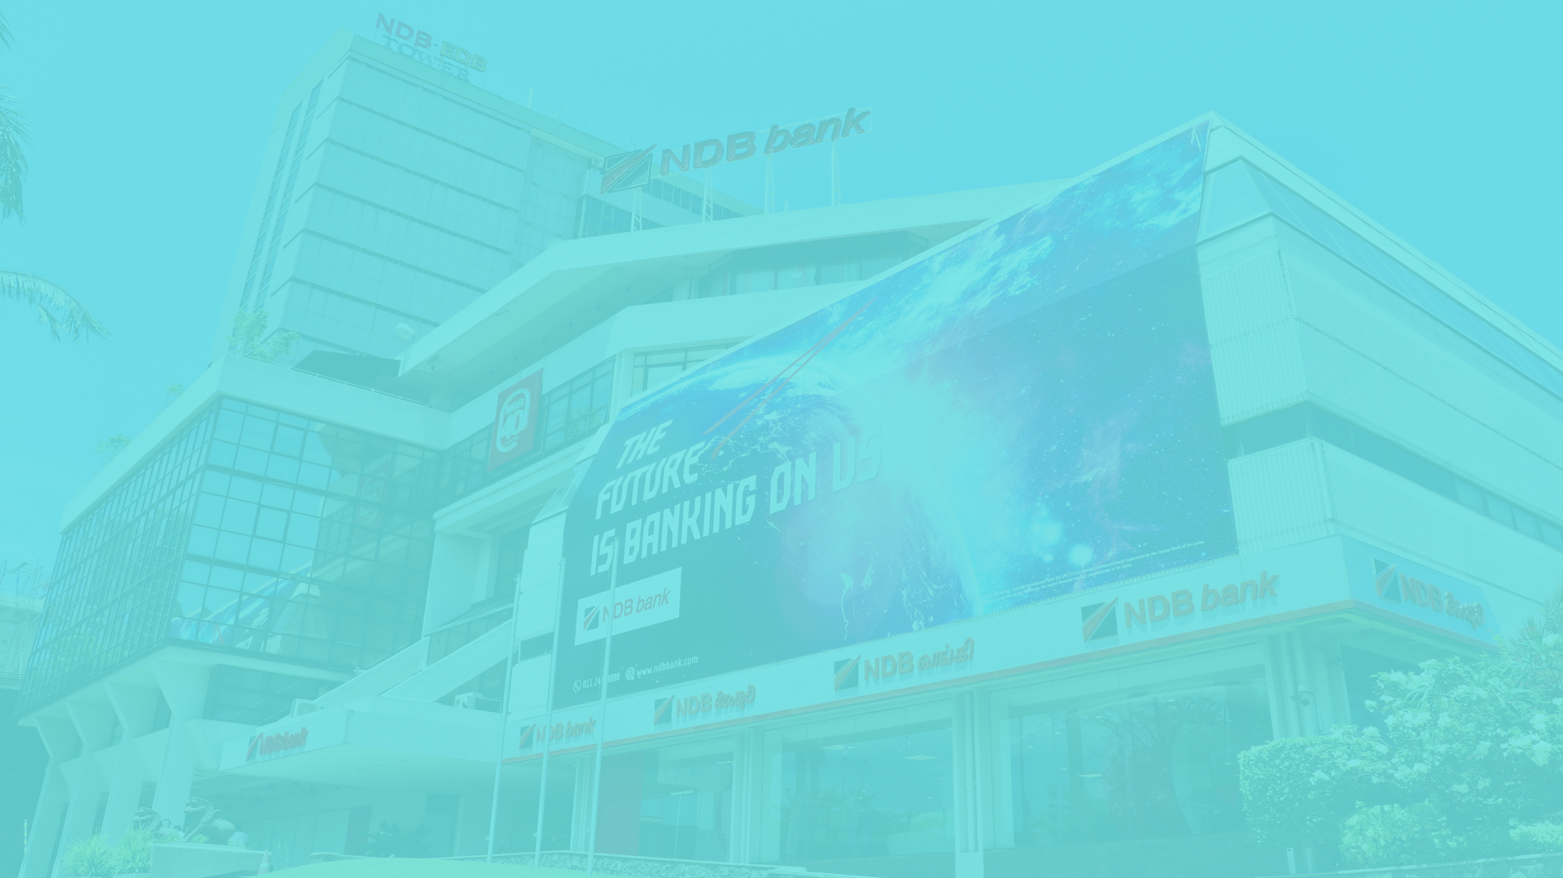

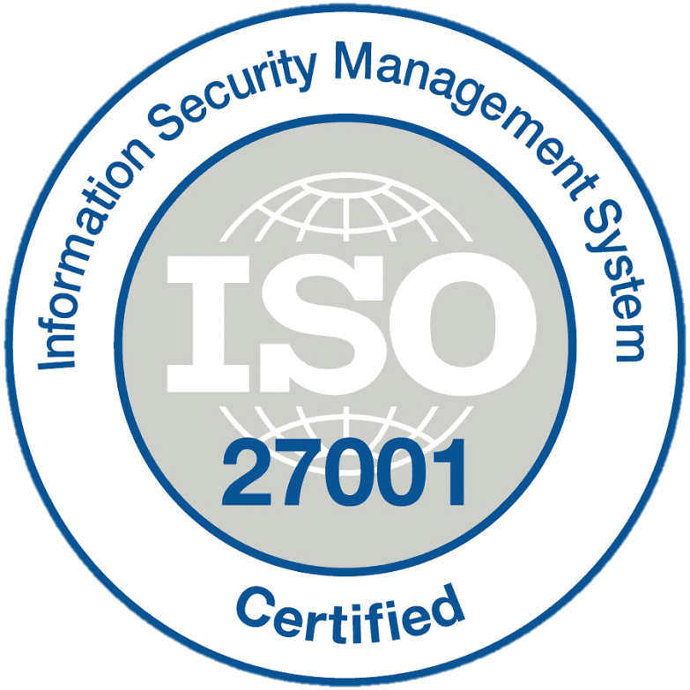







TECHNOLOGY & STANDARDS
Technologies
Standards
ISO 20000 (ITSM) - complied
ISO 20000 (ITSM) - complied
Secure coding standards
Adherence to Industry Coding Standards
Ensures maintainability, efficiency, and high-quality code.
Promotes consistency and reduces technical debt.
Rigorous QA & Sample Testing
Comprehensive quality assurance protocols.
Achieved an impressive accuracy ratio of 99.8%.
Notes:
* These are the technologies we have used to develop ServU.
We are the only bank certify in ISO 27001(2022 latest version) and ISO 22301.
And also we are complied in 20000 ITSM & ISO 27035 (information technology)

Slide 12











SUSTAINABILITY
Environmental
sustainable IT practices by optimizing energy consumption, reducing paper usage, and promoting digital collaboration to minimize environmental impact
Total A4 sheets
Total emission saving
Social
Approx 2500 bundles
12,500kg CO2 per year
Boost External & Internal customer well-being by offering efficient, user-friendly IT support and continuously improving service based on feedback.
Governance
Enhance governance with reporting tools, ethical IT practices, detailed audit trails, effective incident management, performance metrics tracking, and comprehensive asset lifecycle oversight for transparency and accountability.
Number of Trees saved per annum
26 Trees
UN-SDGs
# Using the emission factor of 5 kg CO2 per bundle
Notes:
Marketing story to remain

Slide 13




FUTURE TARGETS & EXPANSIONS
Introducing advanced LLM and machine learning capabilities for predictive analytics and automated issue resolution
Expanding API integrations to include cutting-edge fintech solutions and third-party services
Developing IoT integration for proactive monitoring and maintenance of IT assets
Automating incident creation through incident alerts
Notes:
Predictive analytics and automated issue resolution using LLM (Large Language Model)
Automating incident creation through incident alerts

Slide 14

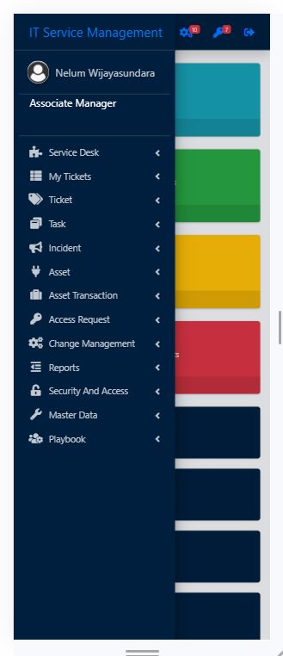


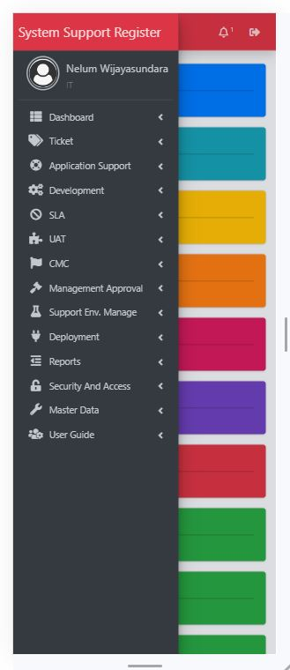
Q and A

Slide 15
Thank you !
Comprehensive IT Service Management Platform

